Slide 1
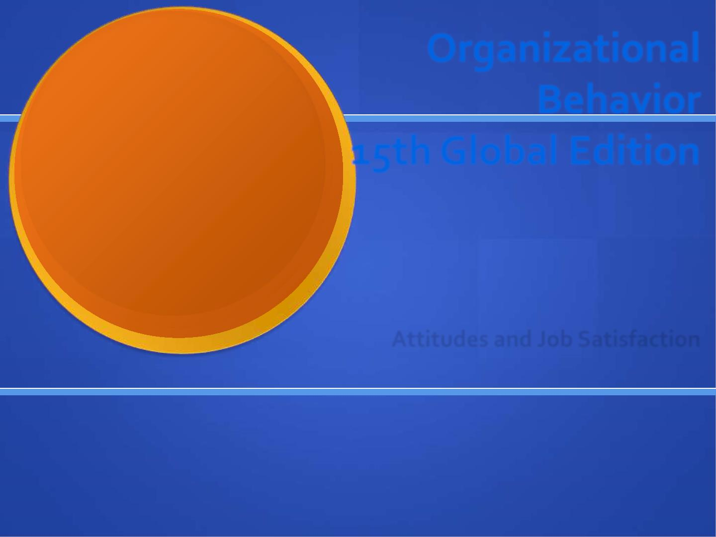
Organizational
Behavior
19th Global Edition
3
Chapter
Robbins and Judge
Job Attitudes
3-1

Slide 2
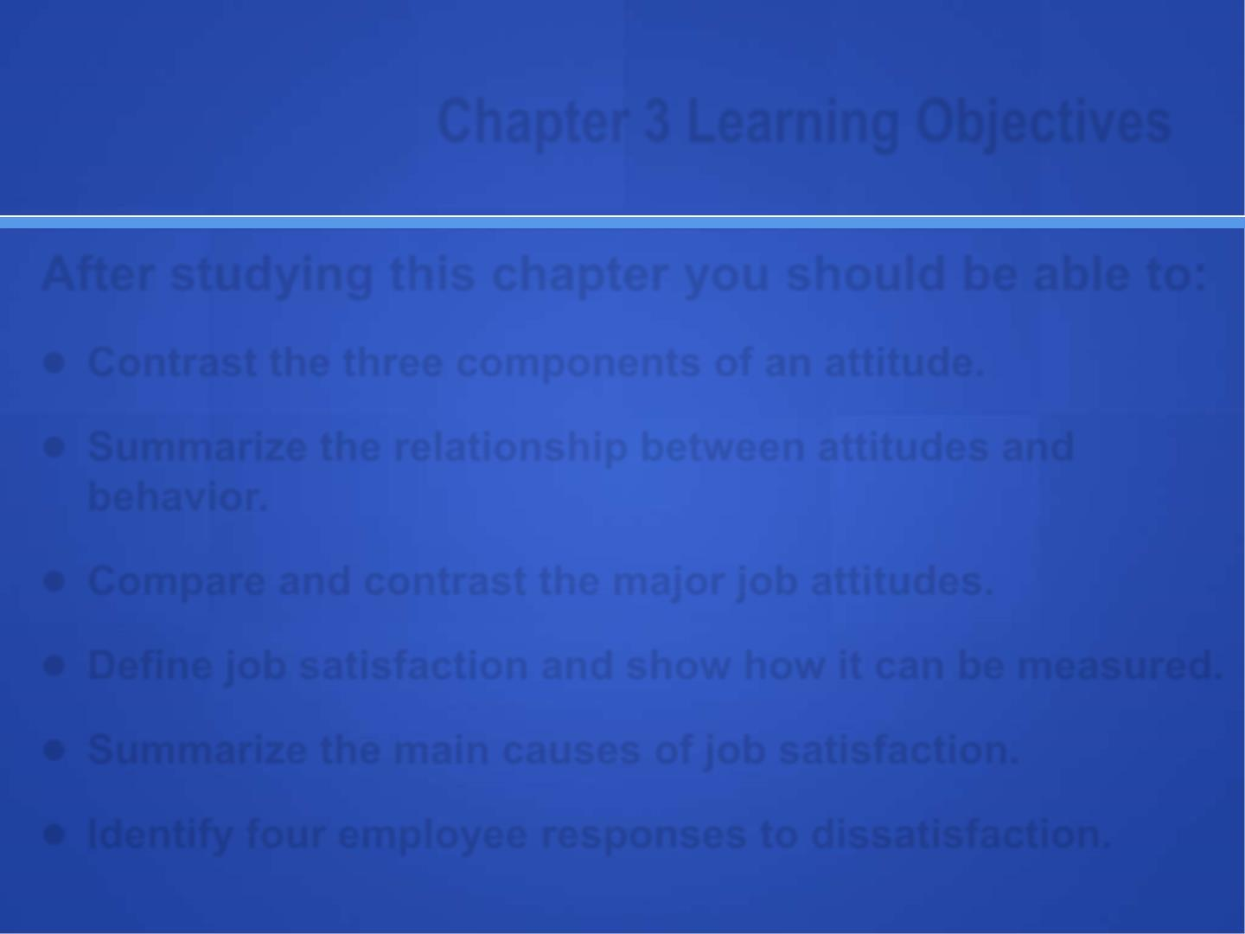
Chapter 3 Learning Objectives
After studying this chapter you should be able to:
● Contrast the three components of attitude.
● Summarize the relationship between attitudes and behavior.
● Compare the major job attitudes.
● Identify two approaches to measure job satisfaction
● Summarize the main causes of job satisfaction.
● Identify four outcomes of job satisfaction.
● Identify four employee responses to dissatisfaction
3-2

Slide 3
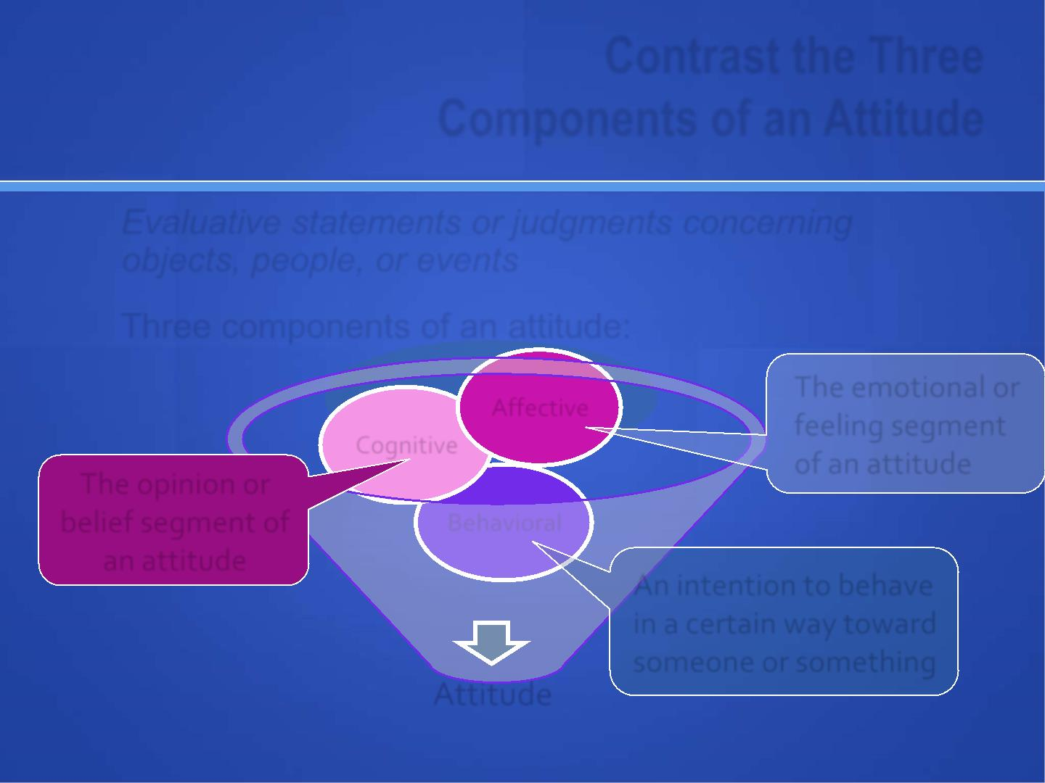
Contrast the Three
Components of an Attitude
Attitude is evaluative statements or judgments, either favorable or unfavorable, about objects, people, or events
Three components of an attitude:
Affective
The emotional or
feeling segment
Cognitive
of an attitude
The opinion or
belief segment of
Behavioral
an attitude
An intention to behave
in a certain way toward
someone or something
ATTITUDE
3-3

Slide 4
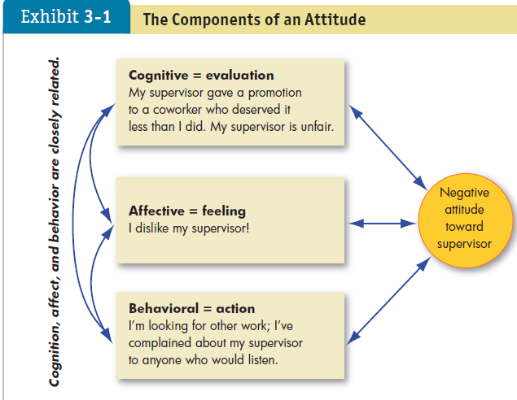

Slide 5
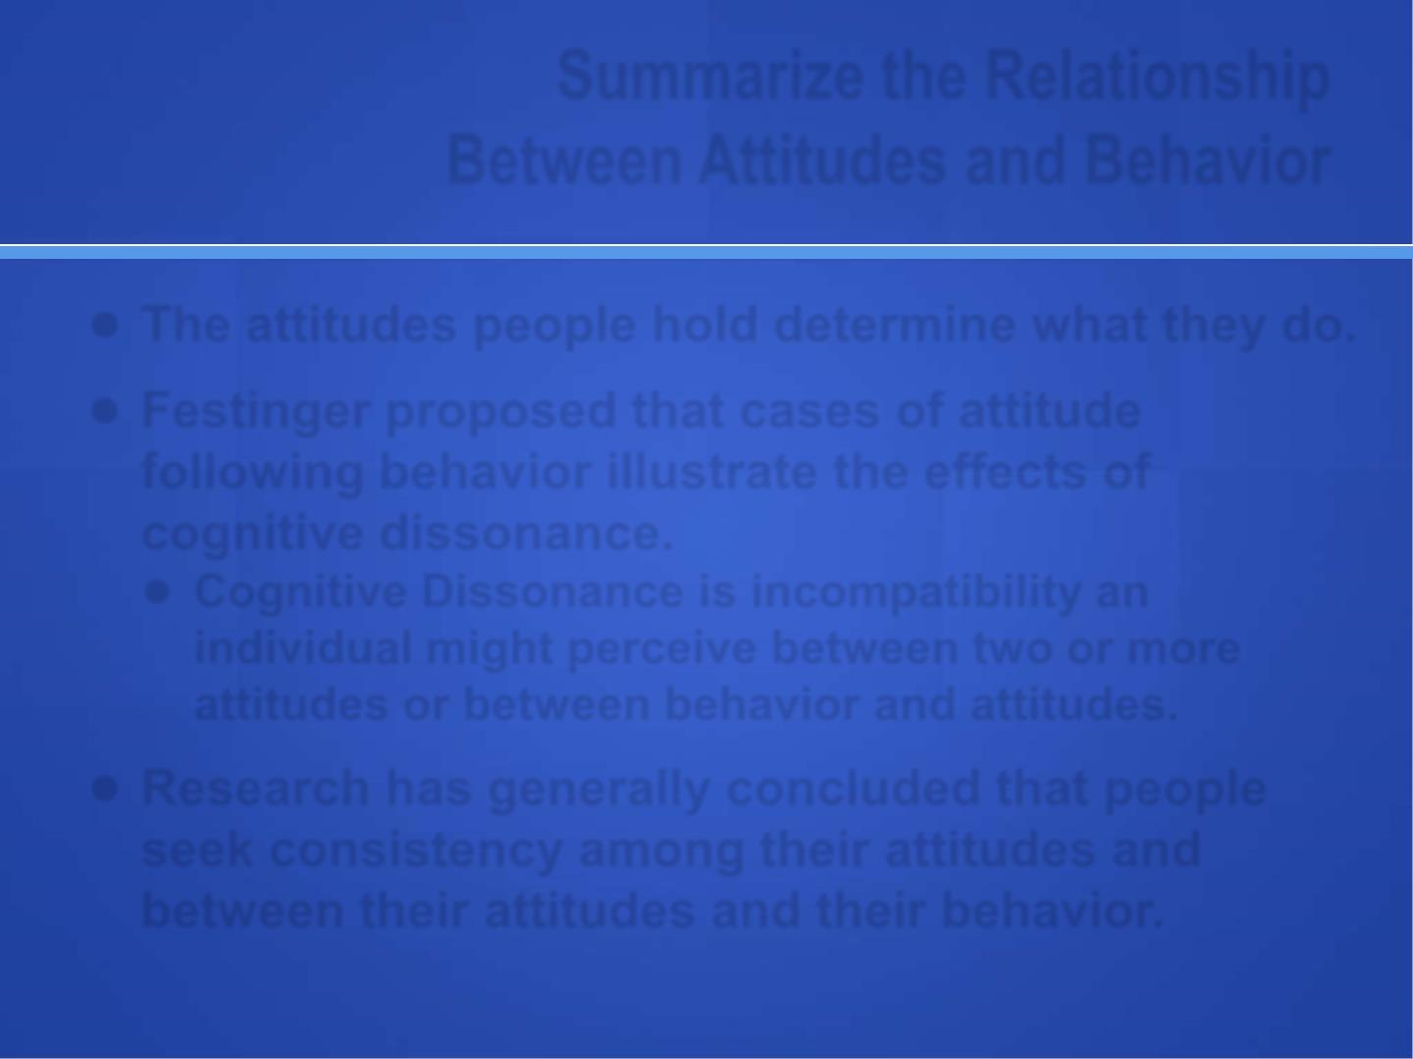
Summarize the Relationship
Between Attitudes and Behavior
● The attitudes people hold determine what they do. Attitudes help predict or cause behaviors.
● Cases of attitude following behavior illustrate the effects of cognitive dissonance.
● Cognitive Dissonance is incompatibility an individual might perceive between their behavior and attitudes. Examples, smoking, texting while driving, etc.
● Research has generally concluded that people seek consistency among their attitudes and between their attitudes and their behavior.
3-5

Slide 6
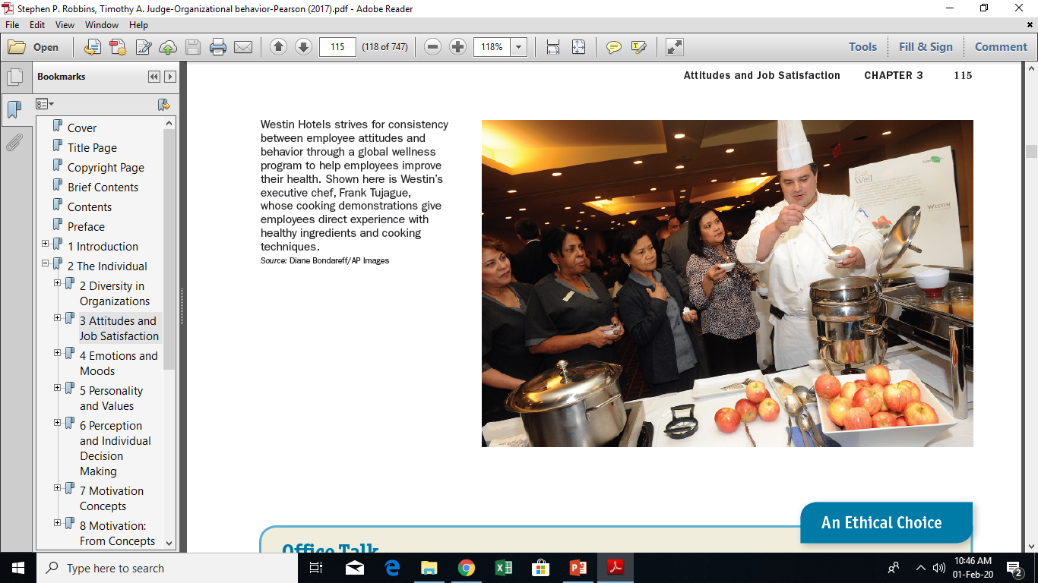

Slide 7
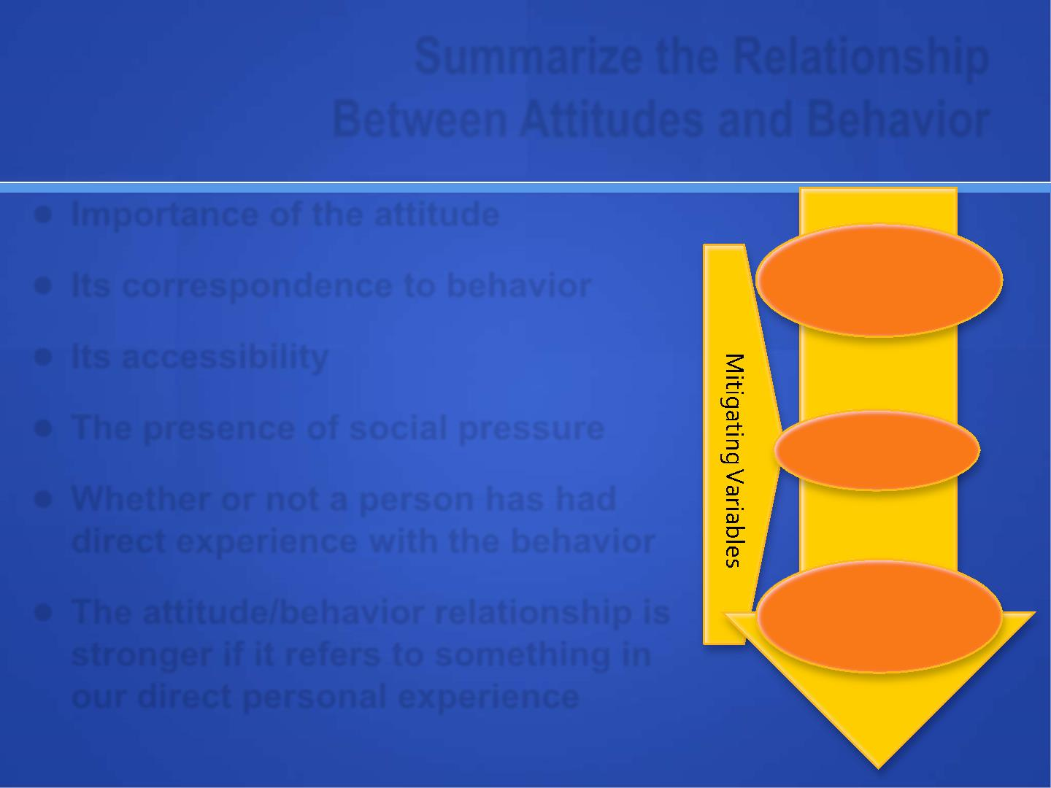
Summarize the Relationship Between Attitudes and Behavior
Importance of the attitude
Its correspondence to behavior
Its accessibility
The presence of social pressure
The attitude/behavior relationship is stronger if it refers to something in our direct personal experience
Attitude
Predicts
Behavior
3-7

Slide 8
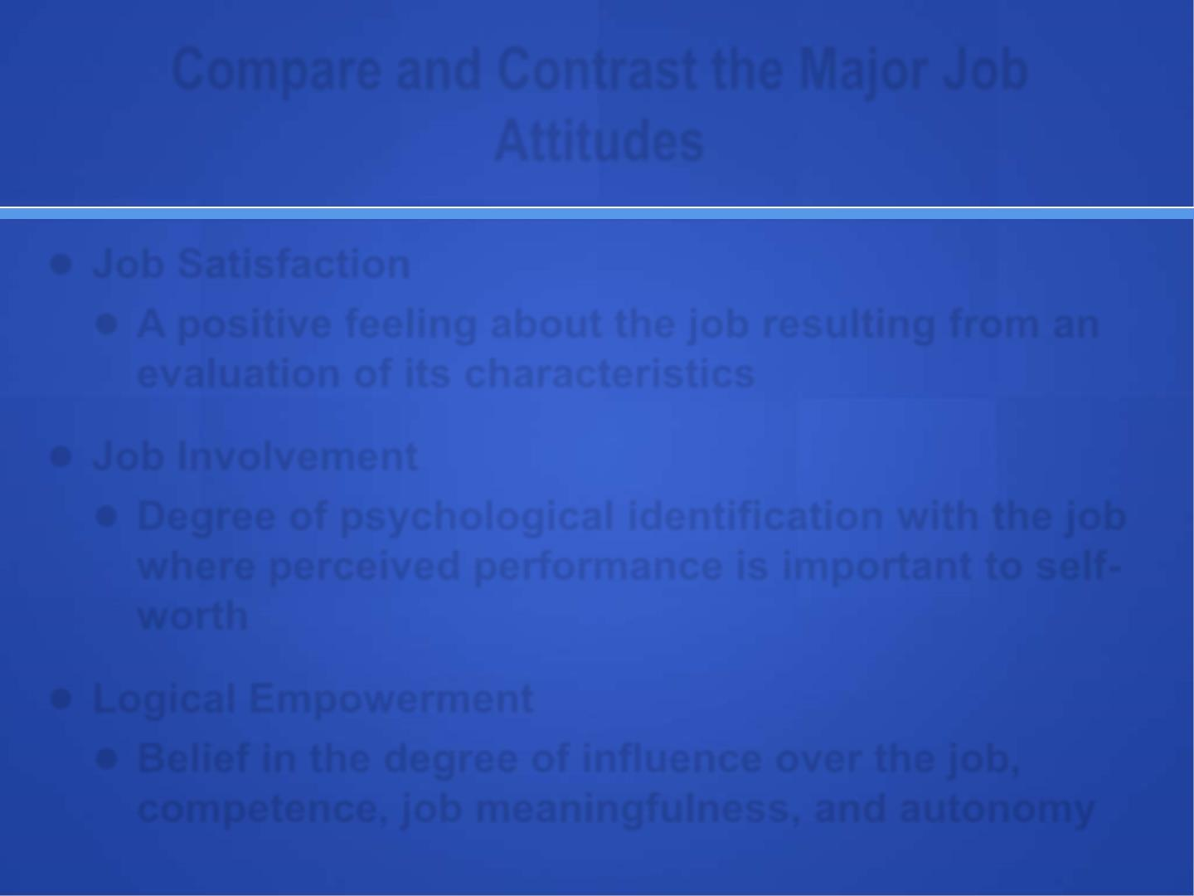
Compare the Major Job Attitudes
● Organizational identification
● The extent to which employees define themselves by the same characteristics that define their organization.
● Job Satisfaction
These attitudes lead to positive behaviors, i.e., OCB, performance.
● A positive feeling about the job, resulting from an evaluation of its characteristics.
● Job Involvement
● Degree of psychological identification with the job, actively participates in it, where perceived performance is important to self-worth

Slide 9
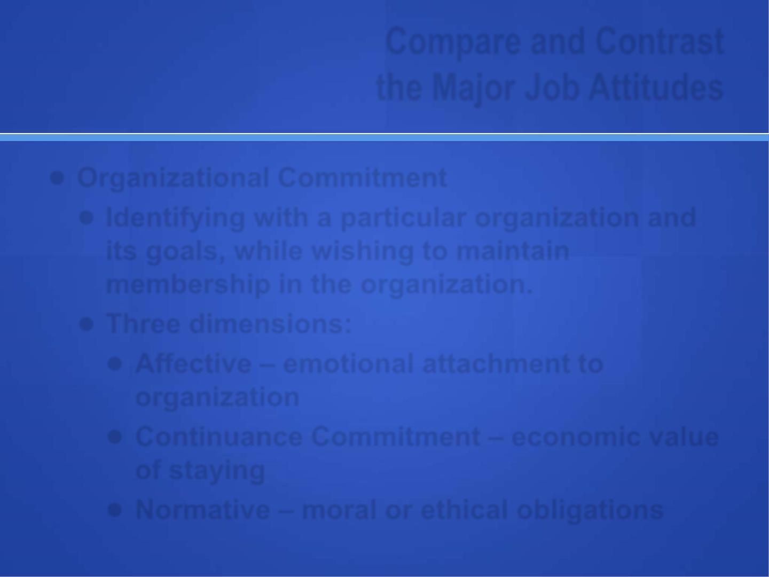
Compare the Major Job Attitudes
● Psychological empowerment
● Employees’ belief in the degree to which they affect their work environment, competence, meaningfulness of their job and autonomy in work
● Organizational Commitment
The degree to which an employee identifies with a particular organization & its goals, while wishing to maintain membership in the organization. Affective, normative & continuance commitment
Employees who are committed will be less likely to engage in work withdrawal even if they are dissatisfied, because they have a sense of organizational loyalty.
3-9

Slide 10
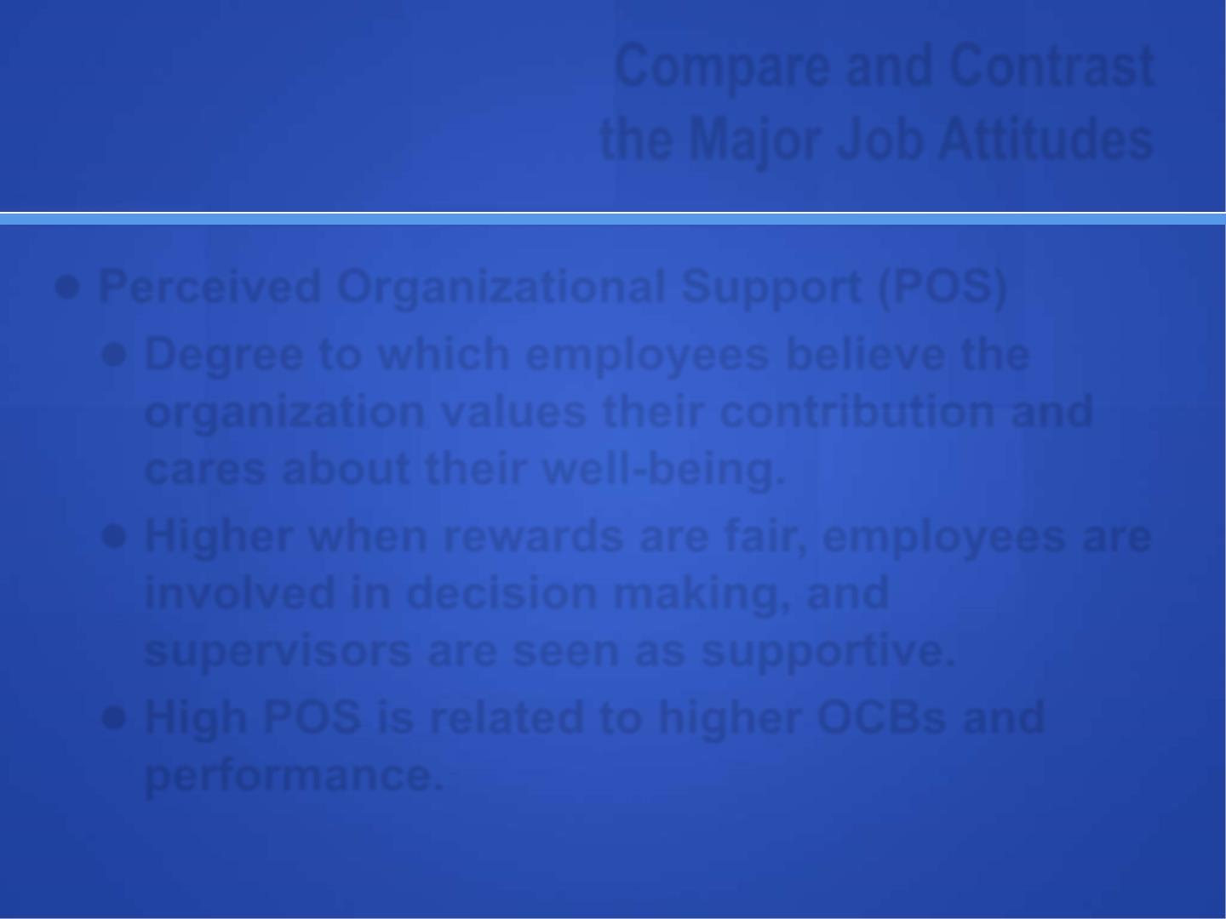
Compare the Major Job Attitudes
● Perceived Organizational Support (POS)
● Degree to which employees believe the organization values their contribution and cares about their well-being.
● POS is higher when rewards are fair, employees are involved in decision making, and supervisors are seen as supportive.
● High POS is related to higher OCBs and performance.
POS and Power Distance (in low PD there is higher POS and vice versa)
3-10

Slide 11
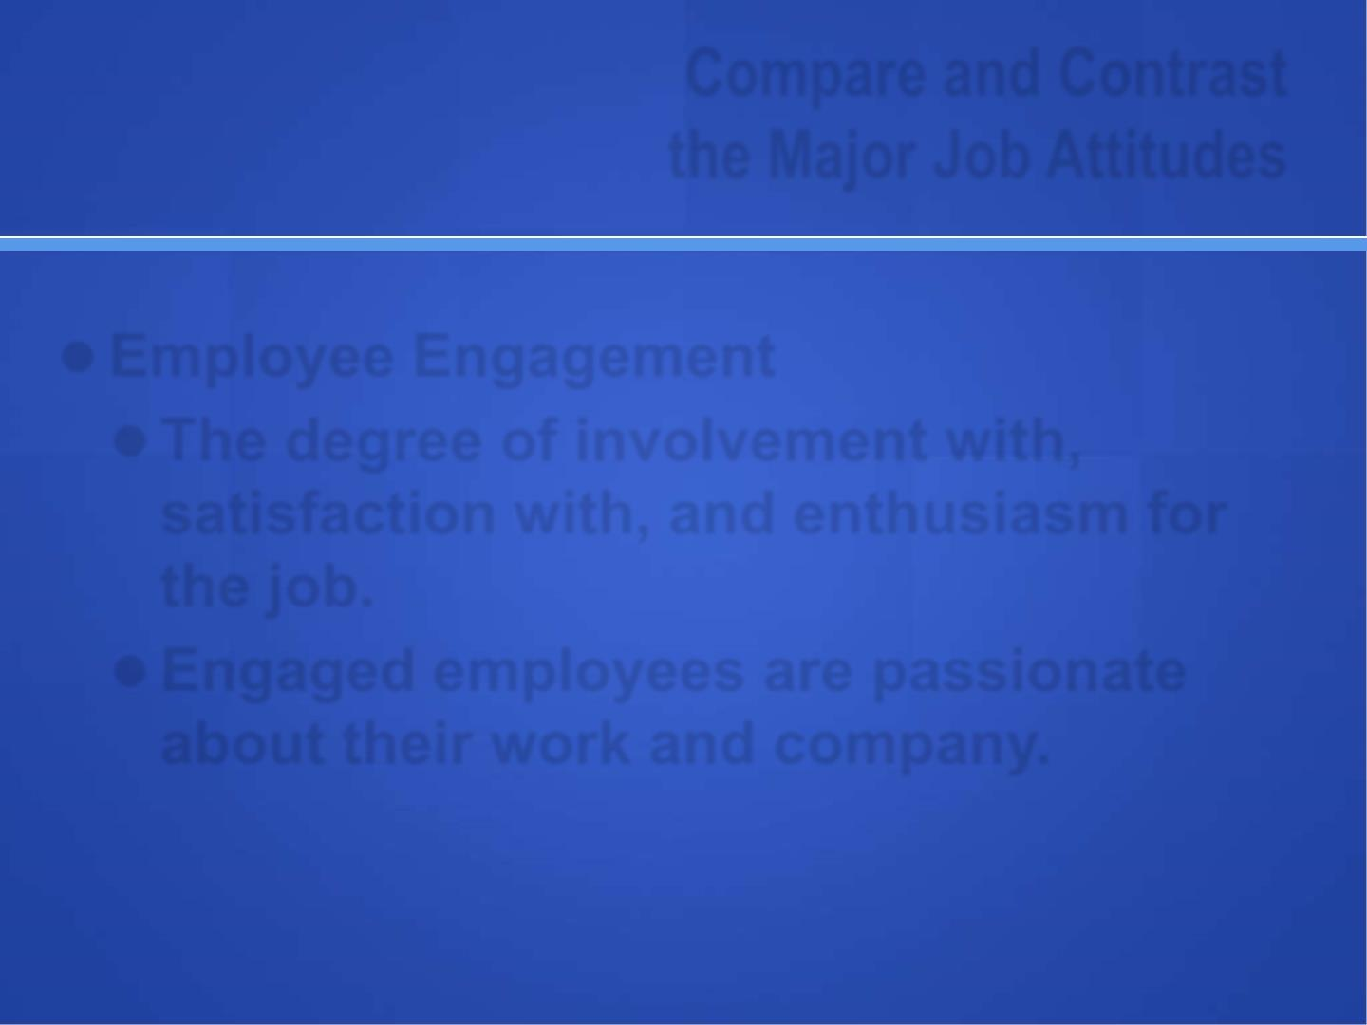
Compare the Major Job Attitudes
● Employee Engagement
● The degree of enthusiasm an employee feels for the job.
● Engaged employees are passionate about their work and company.
 Organizations can use various practices to improve employee engagement
3-11

Slide 12
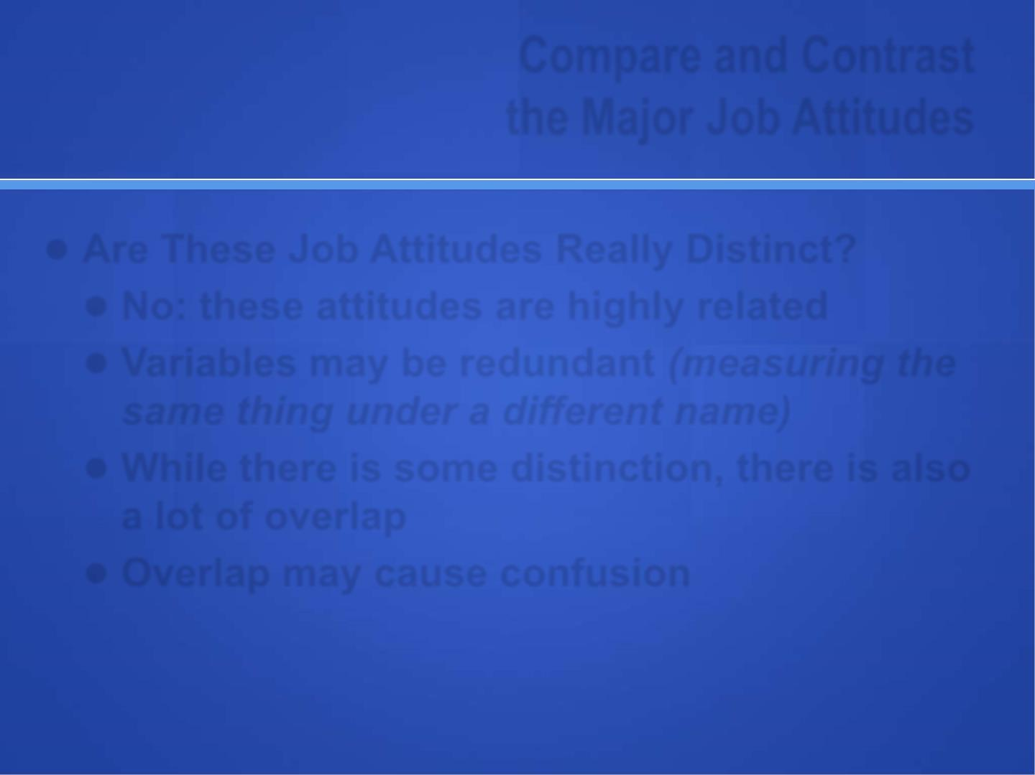
Job Attitudes
● Job Attitudes in the Gig Economy
Personally fulfilling work & socioemotional relations. More satisfied and committed if higher chances of employment.
● Are These Job Attitudes Really Distinct?
● No: these attitudes are highly related
● Variables may be redundant (measuring the same thing under a different name)
● While there is some distinction, there is also a lot of overlap
● Overlap may cause confusion
3-12

Slide 13
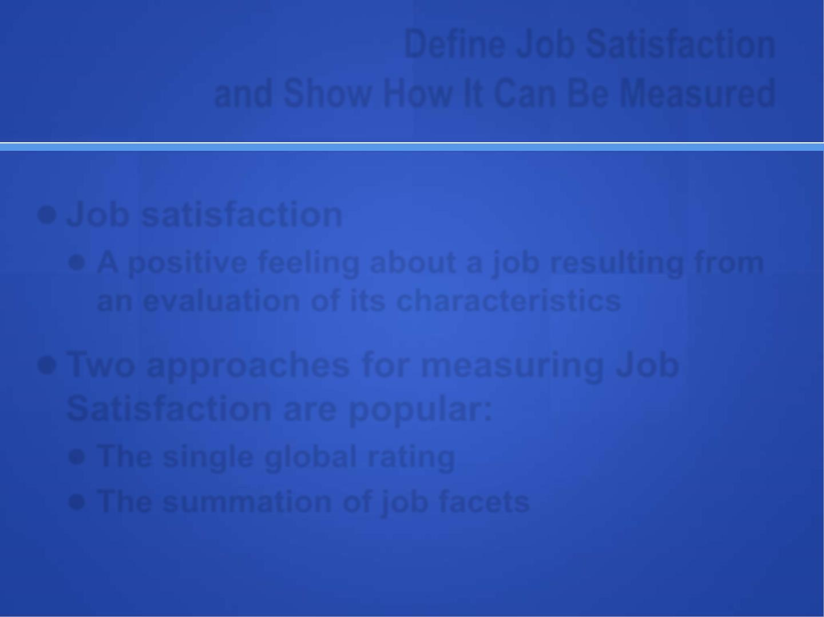
Define Job Satisfaction and Show How It Can Be Measured
● Job satisfaction
A positive feeling about a job resulting from an evaluation of its characteristics.
It is one of the most critical job attitudes and predicts several important business outcomes.
● Two approaches for measuring Job Satisfaction are popular:
● The single global rating (Scale:1-5 – SA to SD)
● The summation of job facets
3-13

Slide 14
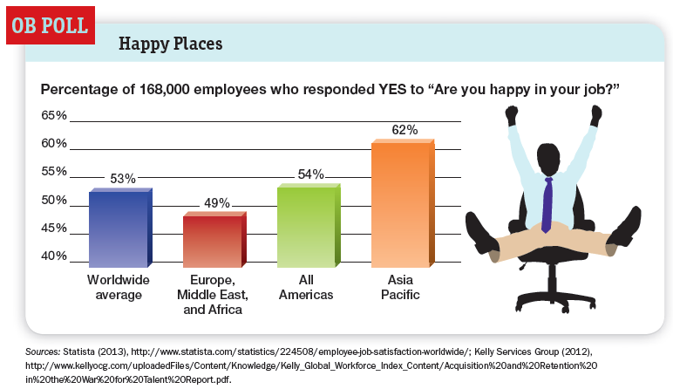

Slide 15
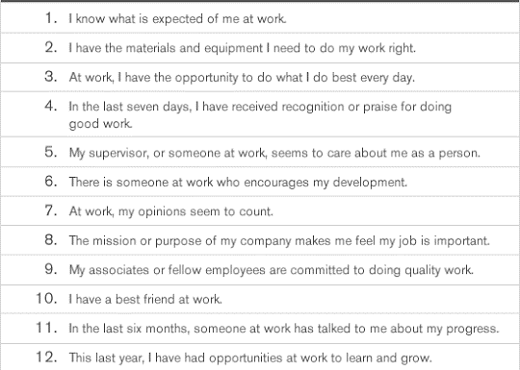

Slide 16
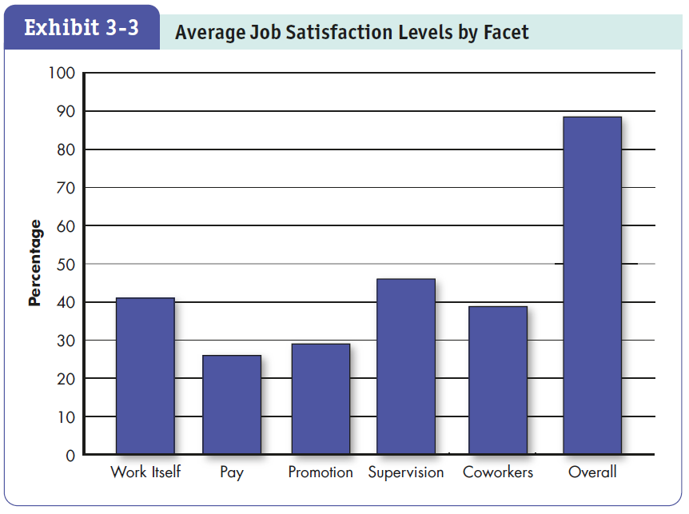

Slide 17
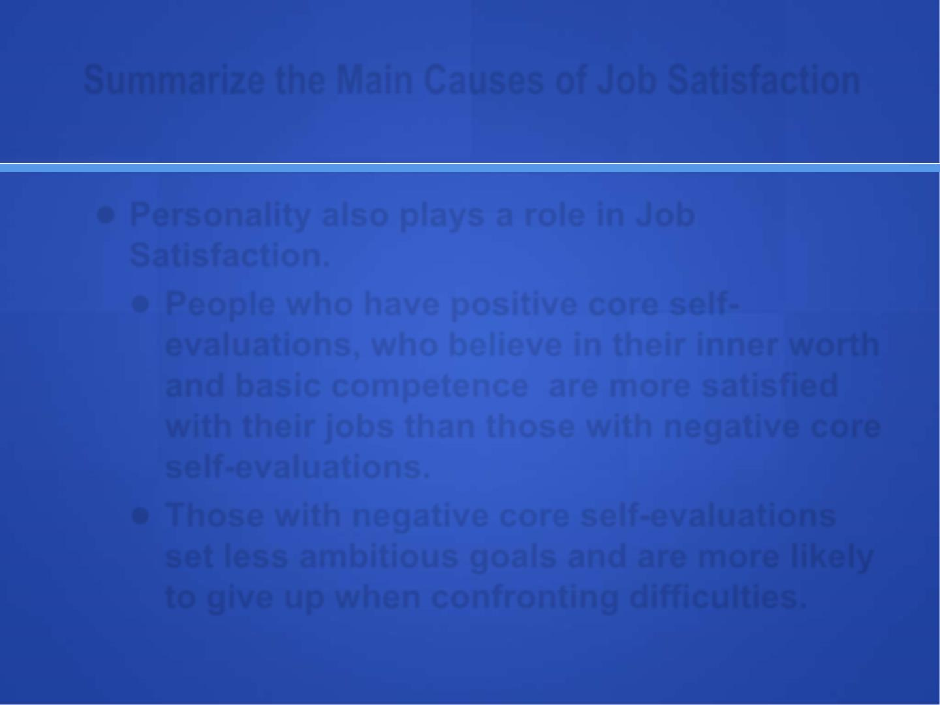
Summarize the Main Causes of Job Satisfaction
● Job Conditions
● Conditions contribute to Job Satisfaction.
Interesting job, good supervisor, autonomy, variety, training, independence, control, interdependence, feedback, social support, leader’s empowerment, etc.
● Studies suggest that manager’s attentiveness, responsiveness and support are high predictors of job satisfaction
● Job conditions—especially the intrinsic nature of the work itself, social interactions, and supervision—are important predictors of job satisfaction.
3-17

Slide 18
Summarize the Main Causes of Job Satisfaction
● Personality and Individual Differences
● These also plays a role in Job Satisfaction. People who have positive core self-evaluations, who believe in their inner worth and basic competence are more satisfied with their jobs than those with negative core self-evaluations.
● Those with negative core self-evaluations set less ambitious goals and are more likely to give up when confronting difficulties.
People with high career/job commitment are also more satisfied.
Match between interest and job nature
3-18

Slide 19
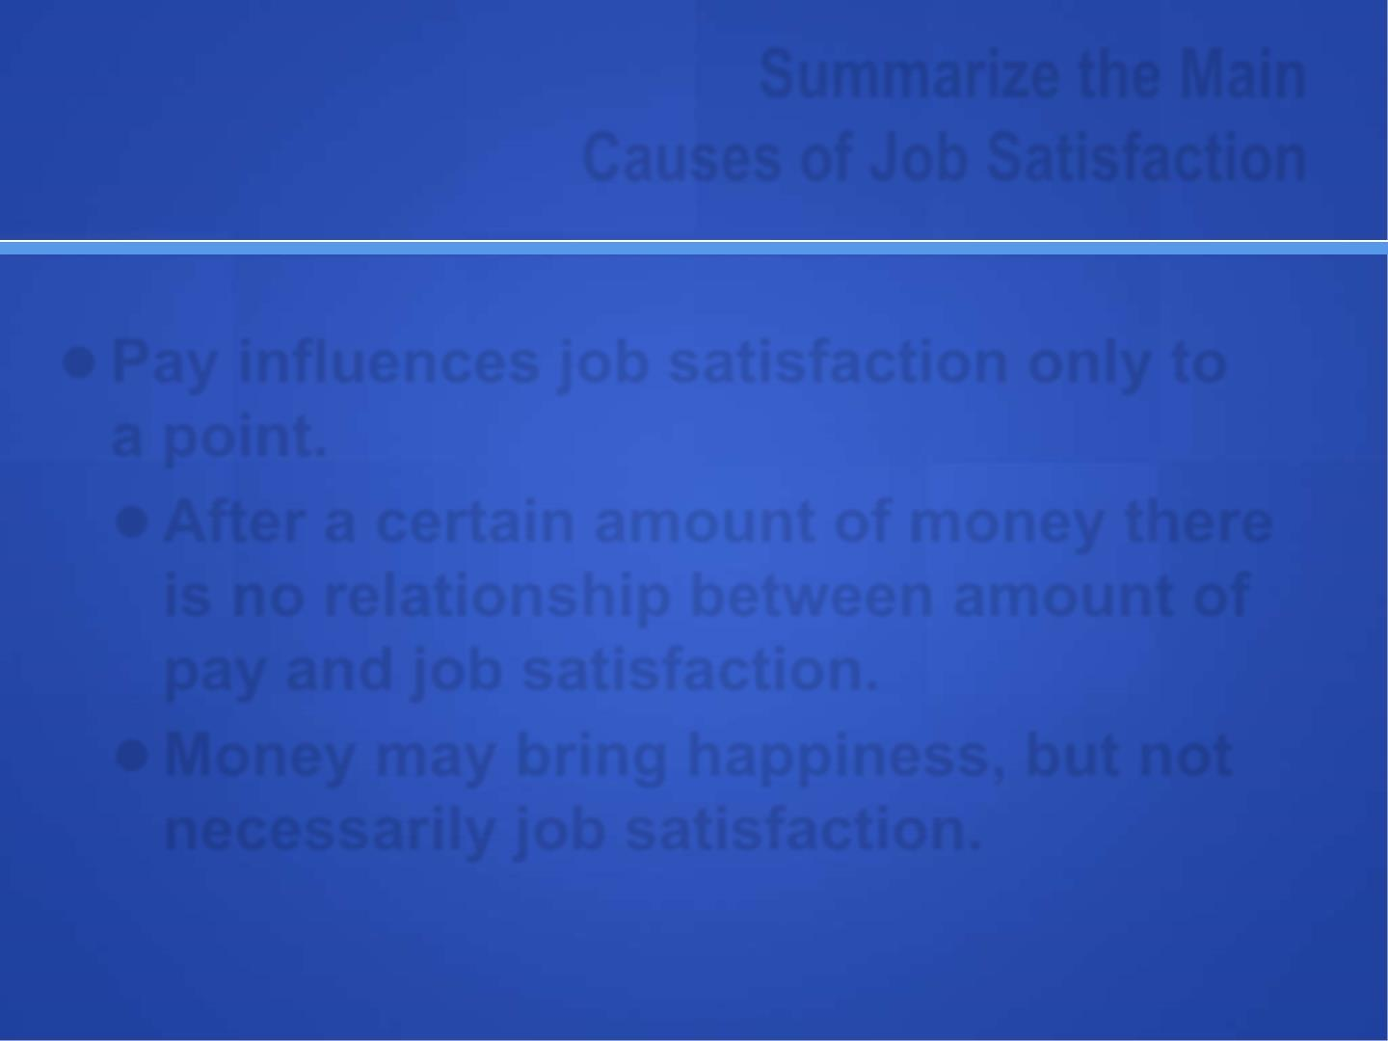
Summarize the Main Causes of Job Satisfaction
● Pay
Pay influences job satisfaction to a certain level.
● After a certain level of career maturity there is little relationship between pay and job satisfaction.
● Money may bring temporary happiness, but not necessarily job satisfaction.
3-19

Slide 20
Outcomes of Job Satisfaction
● Job Performance = Quality + Quantity
● Organizational Citizenship Behavior (Opposite is Counterproductive Work Behavior)
Customer Satisfaction
Life Satisfaction
3-20

Slide 21
The Impact of Job Dissatisfaction
Exit: Dissatisfaction expressed through behavior directed towards leaving the organization
Voice: Dissatisfaction expressed through active and constructive attempting to improve conditions
Loyalty: Dissatisfaction expressed by passively waiting for improvement
Neglect: Dissatisfaction expressed through passively allowing conditions to worsen. Results in chronic absenteeism or late comings, reduced effort, and an increased error rate.
3-21

Slide 22
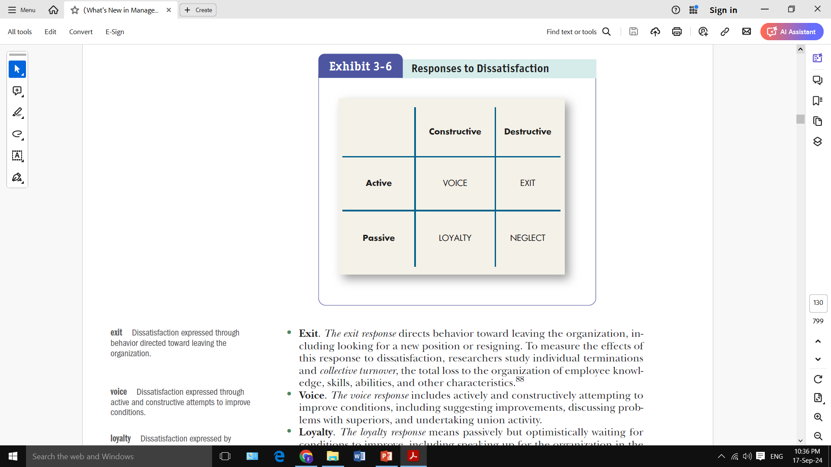
The Impact of Job Dissatisfaction
3-14

Slide 23
The Impact of Job Dissatisfaction
Counterproductive Work Behavior (CWB)
Actions that actively damage the organization, including stealing, behaving aggressively toward coworkers, or being late or absent.
At times absenteeism and turnover in employees.
3-23

Slide 24

“Managers often “Don’t get it”
High Morale Vs Low Morale Companies
100 Best Companies to Work For

